Slide 1
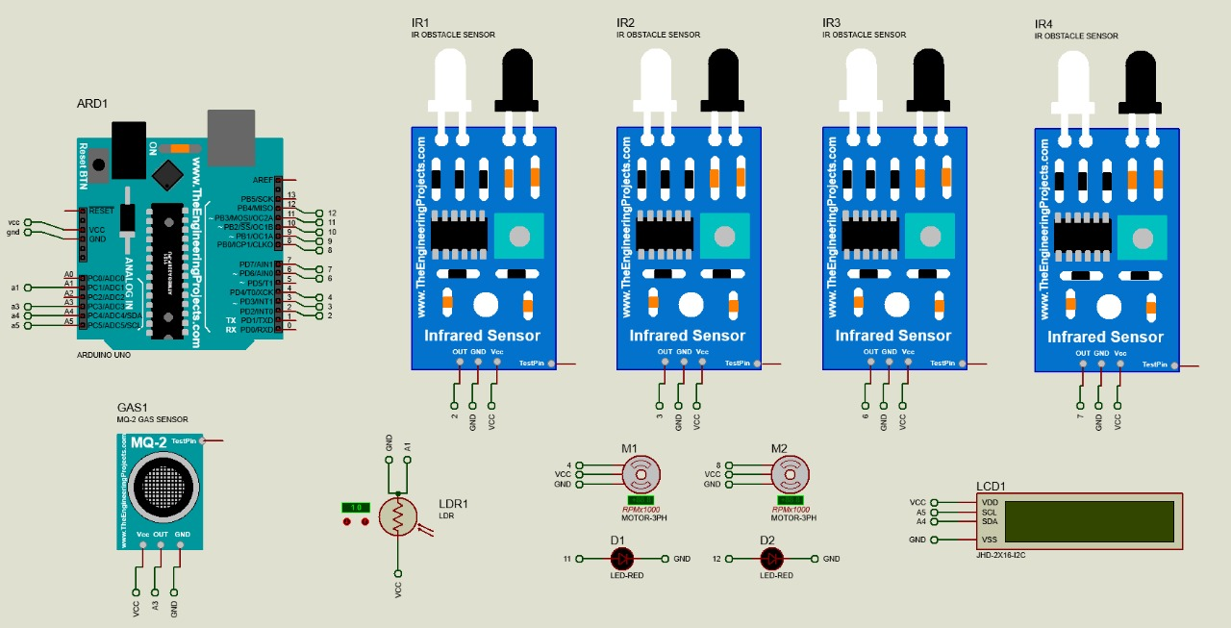
Project Circuit

Slide 2
Sensors Used
IR sensor
MQ5 gas sensor
LDR

Slide 3
IR Module
Infrared Obstacle Avoidance Tracking Sensor
It is a proximity sensor used to determine if an object is within some particular critical distance of the sensor. It gives ON/OFF outputs.
It is a digital, active sensor.

Slide 4
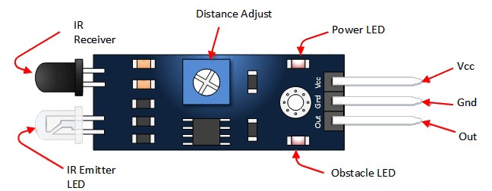
PINS Description & specifications
VCC | 3.3 to 5 vdc
GND | Ground
OUT | The output that goes low when an obstacle is in range
Power LED | Illuminates when power is applied
Obstacle LED | Illuminates when an obstacle is detected
IR Emitter | Infrared emitter LED
IR Receiver | The infrared receiver that receives signal transmitted by Infrared emitter
Response Time: <500ms
Detection range: 2 - 30 cm
Field of view: 10 - 30 degrees

Slide 5
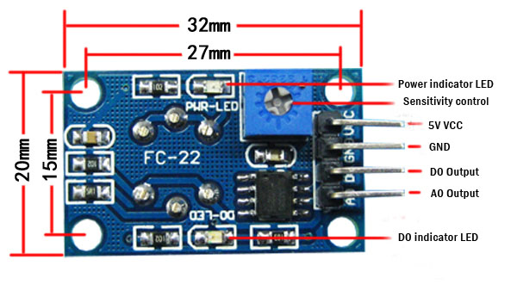
MQ5 gas sensor
It is active, (Analog - Digital) sensor but we used it as analog sensor.
The MQ-5 primarily provides an analog output, which represents the gas concentration as a variable voltage level.
The sensor has a sensitive filament made of SnO2. ... When a combustible gas such as LPG is introduced, the filament conductivity rises, and the amount of change in it's conductance/resistance can be used to indicate the equivalent gas concentration
Vcc: 5V
Detection range: 300 - 10000 ppm
Preheat time: 24 - 48 hours

Slide 6
Working Animation

Slide 7
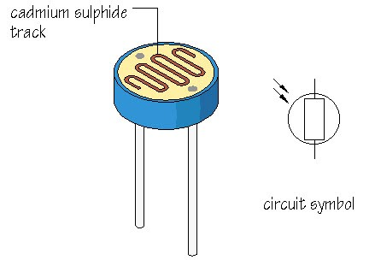
LDR 20mm
Light Dependent Resistor
It is a photoresistor, its resistance change with light intensity.
It is considered a transducer because it converts light energy to change in resistance
High Light Intensity → Low Resistance.
Low Light Intensity → High Resistance.
In bright conditions (e.g., direct sunlight), the resistance might be as low as a few hundred ohms while in darkness, the resistance can rise to several megaohms.

Slide 8
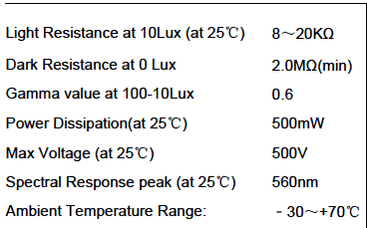
Working Principle & specifications
It is an analog, passive sensor,although a circuit is required to measure the resistance.
The LDR is made of a semiconductor material (commonly cadmium sulfide, CdS) that is sensitive to light. In darkness or low light, the material has high resistance because there are few free electrons to conduct electricity. When light photons strike the surface of the LDR, they provide energy to the electrons in the semiconductor, exciting them into the conduction band. The increase in free electrons reduces the resistance of the LDR.
It is non-linear which means the resistance doesn't change linearly with light intensity.
Response time: ~30ms

Slide 9
THANK YOU
@group6
Ahmed Mohamed Elmetwally
Ashraf Mohamed
Zeyad Bilal
Zeyad Mohamed
Ammar Abdelghany
Mohamed Soliman

